Slide 1
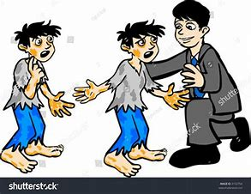
Mini Vinnies
Who We Are and What We Do

Slide 2

The Society of Saint Vincent
De Paul
We are a Catholic charity who work to help the poor all over the world. To help you learn about us, we’re going to do some time travelling!
First stop is all the way back in 1581.
Then we land at 1833.
Before finally retuning to 2019 to see how we very much need your help.
Ready? 3,2,1 lets go!!!!

Slide 3
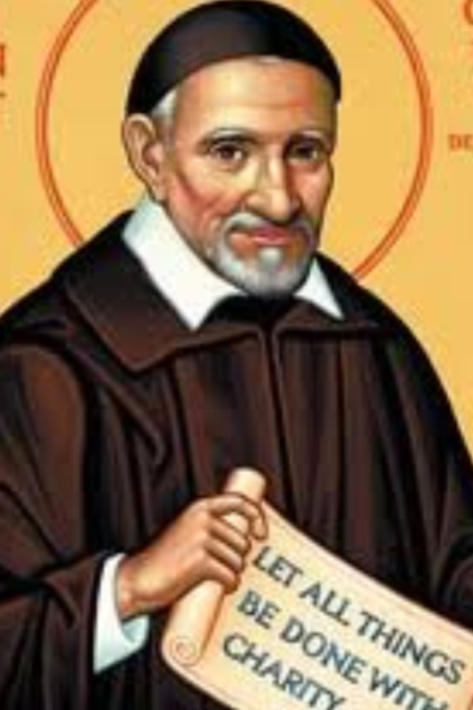
Who was St Vincent De Paul?
Poor peasant farmer boy who was born in 1581 in France.
Loved God and decided to become a priest. However he was happy to have an easy life and associated with rich people.
He was kidnapped by pirates and held as a captive slave for 2 years. He prayed that if God saved him, he would devote his life to helping the poor.
God answered and he escaped back to France. His rich friends helped him with his new mission.
Worked with others to give food, clothing, medicine and shelter to the poor.
Devoted his whole life to the people whom society had forgotten.

Slide 4
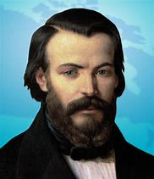
Who was Frederic Ozanam?
Now our time machine is landing in 1833 and we meet a university student called Frederic Ozanam.
Frederic saw how poor the people in Paris were and wanted to help.
He was a Catholic and read stories of the saints. He learned about St Vincent de Paul who had helped the poor of Paris 200 years before.
He gathered his university friends and they made a society which met up often and thought of ways to help the poor, lonely and sick people in Paris.
He needed a name for the new group. Can anyone guess what he called it……?

Slide 5
And the answer is:
The Society of St Vincent De Paul!!!
We now have 8,000 members in 50,000 groups across 155 countries worldwide.
Frederic Ozanam’s wish to have groups of helpers for the poor around the world certainly came true!

Slide 6
Back to The Future!
Our time machine has returned to 2020 but it’s not the end of the story….
In our towns and cities today, people still suffer from poverty, hunger and loneliness.
This is where you can help

Slide 7
Mini Vinnies to the rescue!
A Mini Vinnie group is a child’s version of the society set up by Frederic Ozanam way back in 1833.
You would meet weekly or fortnightly during lunchtime at school or afterschool.
Make new friends.
Think of people who might need some help in your local community.
Plan Ways to help. These could be….

Slide 8
Helping ideas….
Cake and candy
Sponsored events
Making items to sell to donate money to the poor.
Making soup and sandwiches at school which can be given out to homeless groups.
Vising care homes to have a chat with the older residents
Set up a lunch club at school to make sure everyone is included and has friends.

Slide 9
What qualities do we need?
Charity – Frederic Ozanam wanted to “Embrace the World in a network of Charity”.
Empathy – This is when we think of how difficult life is for others and realise how we would feel if it were us.
Simplicity – we help with the basics – food, clothing, companionship.
Justice- We help people who are treated unfairly or left out in society.
Spirituality – We see Christ in the poor and needy as we offer a helping hand. We pray together and practice the Gospel values through our work.

Slide 10
“Christianity is not about ideas, but about deeds inspired by Love."
Blessed Frederic Ozanam
Notes:
Quotes by Religion:
"No matter the nationality, no matter the religion, no matter the ethnic background, America brings out the best in people."
"We must stand up and fight for an America that welcomes young doers and dreamers instead of categorically denying entry to so many simply based on their religion or country of origin."
"The Bible is worth all the other books which have ever been printed."
"Every high school and college graduate in America should, I think, have some familiarity with statistics, economics and a foreign language such as Spanish. Religion may not be as indispensable, but the humanities should be a part of our repertory. They may not enrich our wallets, but they do enrich our lives. They civilize us. They provide context."
"If there is a national, secular religion in the United States, it is the belief that America is the Land of Opportunity, that we are a meritocracy, that any kid, no matter who they are, or where they come from, can work hard and move up in the world: that their effort matters."
"Corporate America limits the world to consumerism. Science can limit it to the material world. Even religion limits it to a lot of theories that can explain everything. I think we need cinema to break that apart and remind us that we're not in control, and we don't understand as much as we think do."
"We have this idea in our minds that there's this separation of church and state in America, which I think is a good thing. And we extend that to our politics - not just church and state, but it's also there's a separation of religion and politics. But of course there isn't."
"The concept of God in America is very different than it is in England. Because we see the horrendous outcome of religion as being an American thing, in which the name of God has been hijacked by a gang of psychopaths and bullies and homophobes, and the name of God has been used for their own twisted agendas."
"The essence of America - that which really unites us - is not ethnicity, or nationality or religion - it is an idea - and what an idea it is: That you can come from humble circumstances and do great things."
"The American free enterprise system is the greatest tool to lift people out of poverty ever created in human history and when applied properly, does not discriminate by race, religion, or skin color."

Slide 11
Next Steps In Becoming a Mini Vinnie
Have a chat to your friends and talk about becoming a Mini Vinnie
Speak to your teacher who will let me know
A welcome pack will be sent from SSVP
Your teacher will stay in touch with me and keep me updated on your progress.
Your Mini Vinnie Work can count towards your Pope Francis Faith Award
I can come to visit your Mini Vinnie group and see how its going.
Your Mini Vinnie group may be featured on The Society of Saint Vincent De Paul Website, Facebook Page or Newsletter. But more importantly…..

Slide 12

You’ll be reaching out to people in need in your community and making a real improvement to their lives.
This Photo by Unknown Author is licensed under CC BY
Notes:
Quotes by Religion:
"No matter the nationality, no matter the religion, no matter the ethnic background, America brings out the best in people."
"We must stand up and fight for an America that welcomes young doers and dreamers instead of categorically denying entry to so many simply based on their religion or country of origin."
"The Bible is worth all the other books which have ever been printed."
"Every high school and college graduate in America should, I think, have some familiarity with statistics, economics and a foreign language such as Spanish. Religion may not be as indispensable, but the humanities should be a part of our repertory. They may not enrich our wallets, but they do enrich our lives. They civilize us. They provide context."
"If there is a national, secular religion in the United States, it is the belief that America is the Land of Opportunity, that we are a meritocracy, that any kid, no matter who they are, or where they come from, can work hard and move up in the world: that their effort matters."
"Corporate America limits the world to consumerism. Science can limit it to the material world. Even religion limits it to a lot of theories that can explain everything. I think we need cinema to break that apart and remind us that we're not in control, and we don't understand as much as we think do."
"We have this idea in our minds that there's this separation of church and state in America, which I think is a good thing. And we extend that to our politics - not just church and state, but it's also there's a separation of religion and politics. But of course there isn't."
"The concept of God in America is very different than it is in England. Because we see the horrendous outcome of religion as being an American thing, in which the name of God has been hijacked by a gang of psychopaths and bullies and homophobes, and the name of God has been used for their own twisted agendas."
"The essence of America - that which really unites us - is not ethnicity, or nationality or religion - it is an idea - and what an idea it is: That you can come from humble circumstances and do great things."
"The American free enterprise system is the greatest tool to lift people out of poverty ever created in human history and when applied properly, does not discriminate by race, religion, or skin color."

