Slide 1

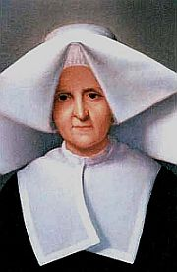

Feast Of Blessed Rosalie Rendu 7th February
Vinnies Info point: VIP’s @SSVP
Who was Sr Rosalie Rendu?

Slide 2
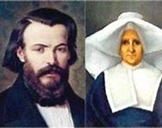
Sr Rosalie and The Society of St Vincent de Paul
Sr Rosalie Rendu is honored as an important person in the formation of the Society of St Vincent de Paul.
She was already helping the poor on the streets of Paris when the Society began. She taught Frederic Ozanam and his friends where to find the poor and how to reach out to them.
Without her, they may not have helped as many poor people as they did, and the Society may not have grown into the worldwide charity it is today.

Slide 3
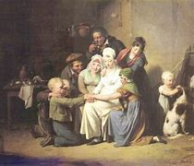
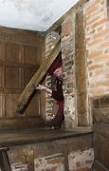
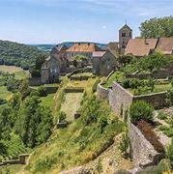
Early Life
Rosalie Rendu was born in the Jura Mountains of France.
She lived happily until her father and baby sister died.
Her family were good Catholics and helped to hide priests who were being chased by the authorities.
Family life
The Mountains of Jura
Priests had to hide and say mass in secret.

Slide 4
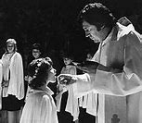
Spiritual and
Family Life
She made her First Holy Communion in the basement of her family home by candlelight.
The Bishop of Annecy was hiding as a farmworker with her family to avoid being captured.
She worked hard to help her mother with her siblings after her father died.
Her love of God grew as she cared so deeply for others and wanted to help the poor and sick as much as she could.

Slide 5
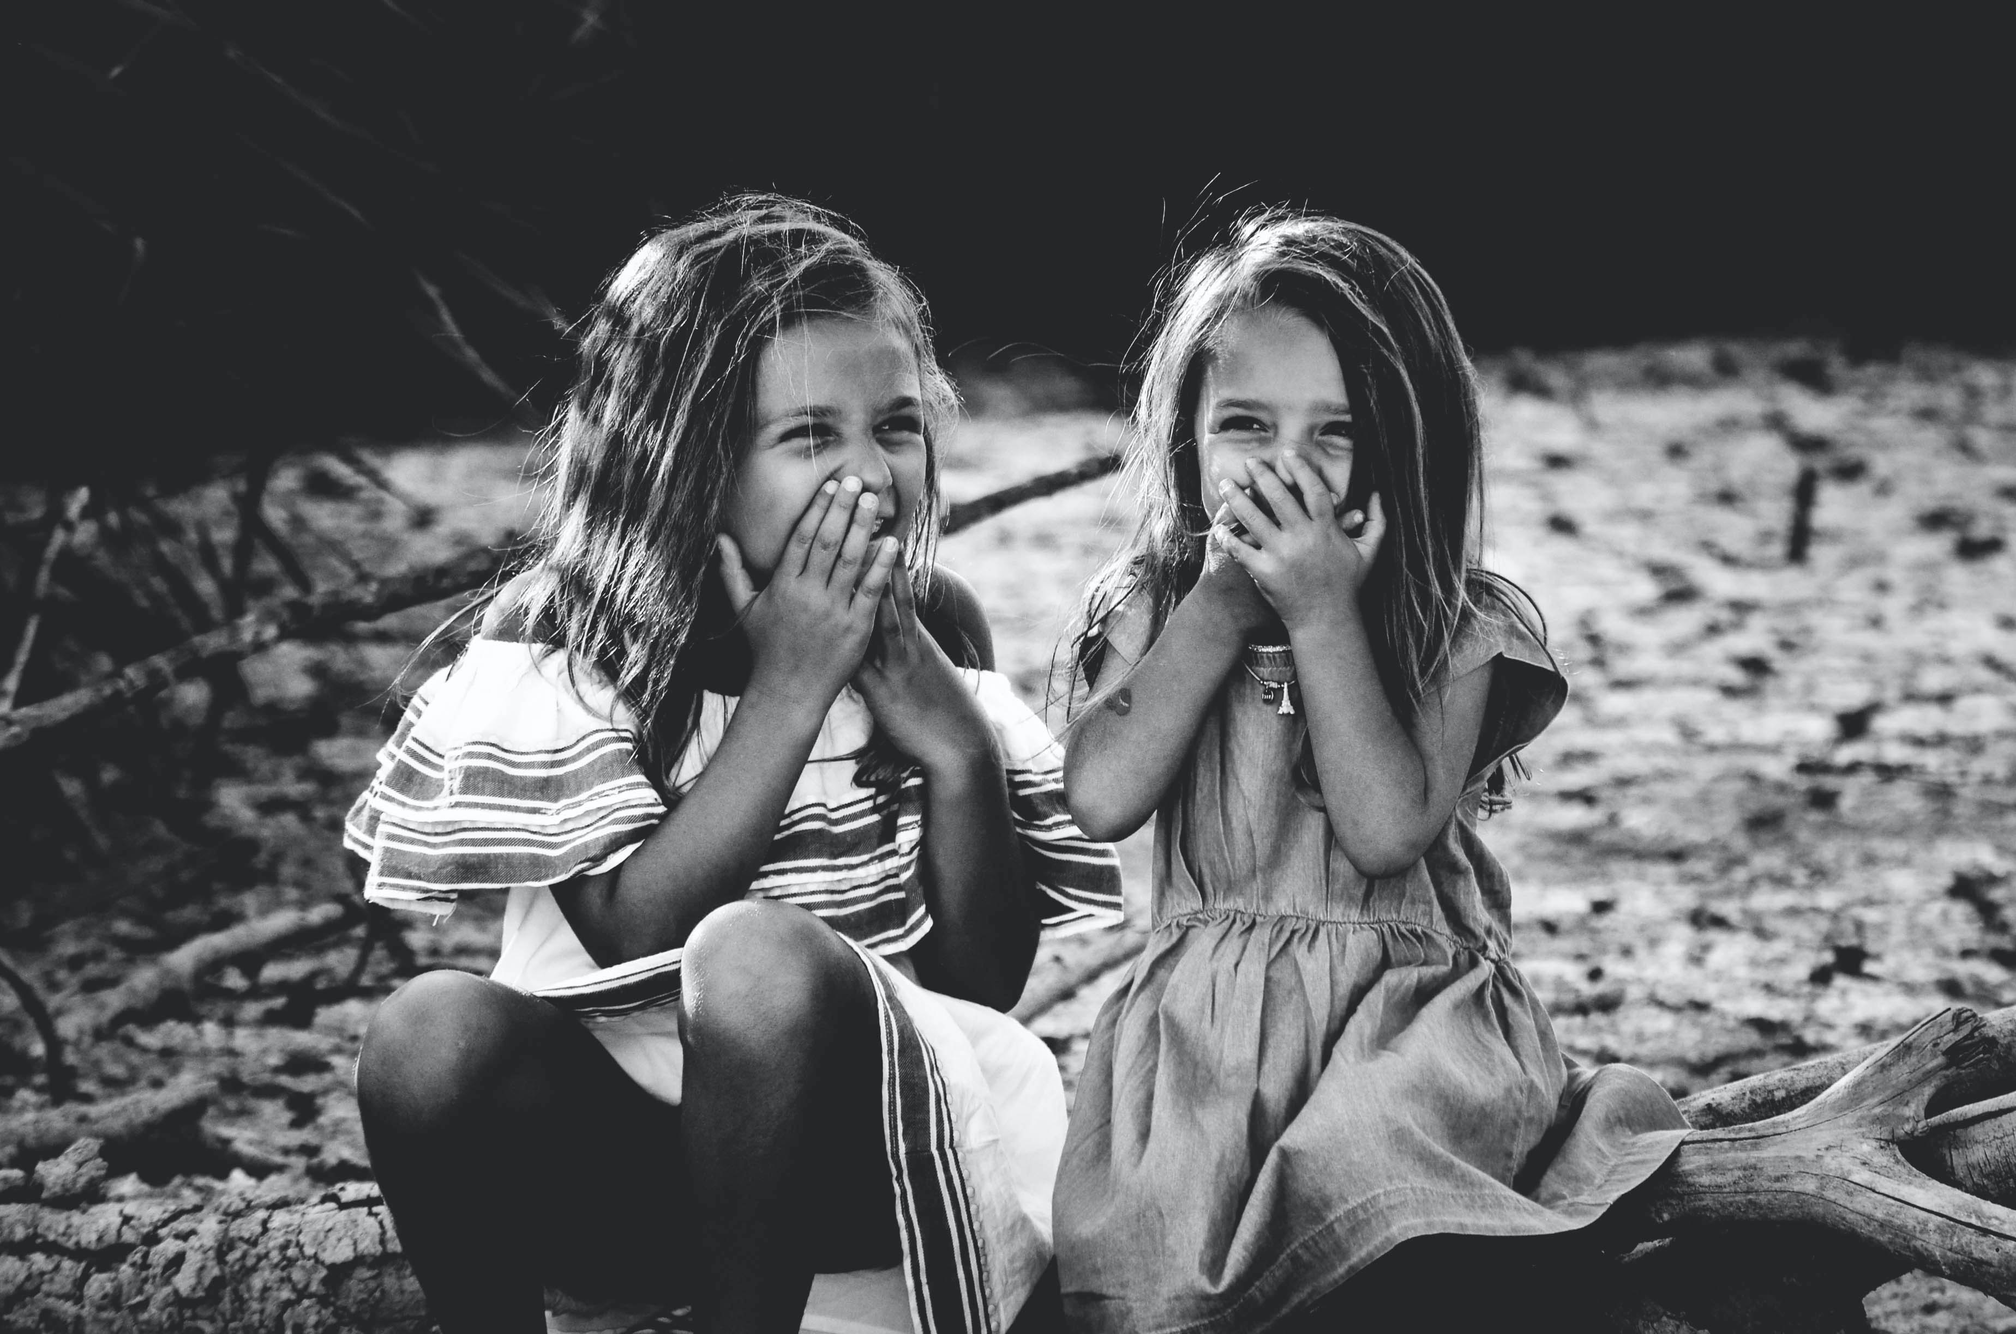
Her cousin said that Rosalie was full of fun as a child and loved nothing better than getting up to a bit of mischief including throwing her sister’s doll over the garden wall!
Good, but not perfect!
Although she liked to have fun and was playful, she had a strong sense of right and wrong. This grew in her heart as she got older and made her want to help the poor and the sick.

Slide 6
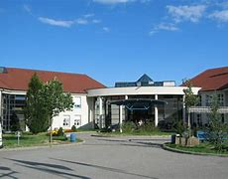
Rosalie is called to serve God
Rosalie begged her mother to allow her to volunteer in the hospital at Gex, pictured left as it is today.
It was here that she met the Daughter’s of Charity, the religious order set up by St Vincent de Paul himself, 200 years before.
When she saw how they helped others she knew she wanted to be part of their mission.

Slide 7
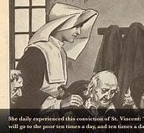
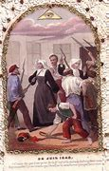
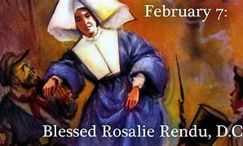
Rosalie In Paris
Sr Rosalie moved to a poor district of Paris.
She visited the sick and homeless daily, praying as she walked the streets.
She even climbed the barricades during French Revolution, to rescue injured soldiers, no matter what side they fought on.

Slide 8
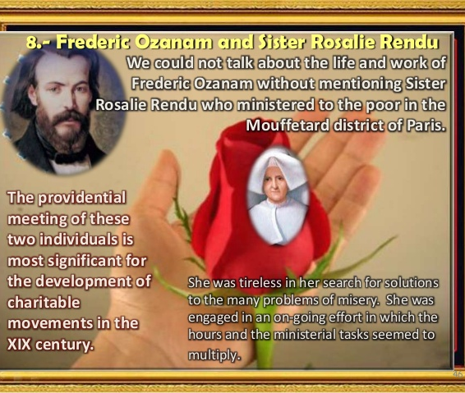
The Society of St Vincent de Paul
Sr Rosalie was the natural choice for Frederic Ozanam to call on for help with his new charity group.
Despite being very busy herself, Sr Rosalie welcomed him, teaching him where to find the poor. She willingly shared her experience of how best to help them.

Slide 9
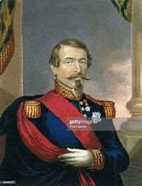
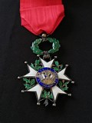
Paupers, Princes and Emperors
Among her most famous supporters were Emperor Napoleon III and his wife and the ambassador for Spain
Sr Rosalie’s reputation spread throughout the city and the country. She had many friends among the rich and they often came to visit her and donate money to her work with the poor.
Napoleon awarded Rosalie the Cross of the Legion of Honour which she reluctantly accepted.

Slide 10
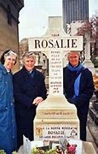
A Fitting Memorial
Sr Rosalie died on 7th February 1856.
She was 70 years old and had been a Daughter of Charity, following the teachings of St Vincent de Paul for 54 years.
Her funeral procession was followed by over 50,000 people from all walks of life- rich and poor, old and young and everything in between.
Rosalie was made Blessed by Pope John Paul II on 9th November 2003. We continue to pray to her, asking her guidance and hoping for the day to come soon when she will become a Saint.

Slide 11
Bibliography:
Rosalie Rendu (vinformation.org)
Rosalie Rendu (1786-1856), biography (vatican.va)
Sister Rosalie Rendu - St Vincent de Paul Society - Good Works (vinnies.org.au)
Rosalie Rendu - We are Vincentians
Produced By Pauline Bonnar,
Youth Development Co-Ordinator SSVP Scotland February 2021

Slide 12

