Slide 1


Blessed are the Merciful
Society of Saint Vincent de Paul: Scotland
October 2016

Slide 2
I think we too are the people who, on the one hand, want to listen to Jesus, but on the other hand, at times, like to find a stick to beat others with, to condemn others. And Jesus has this message for us: mercy. I think — and I say it with humility — that this is the Lord's most powerful message: mercy. Pope Francis Homily March 2013
Blessed are the Merciful

Slide 3
“Let us weep for the misfortune of our oppressed brothers; let us weep for the cruelty of our brothers the oppressors.” (Frederic to Materne, 1829)
Blessed are the Merciful

Slide 4
“Go to the poor: you will find God.” Saint Vincent de Paul “The Spirit of the Lord is upon me, therefore he has anointed me. He has sent me to bring good tidings to the poor.” (Lk 4.18)
Blessed are the Merciful

Slide 5
“The poor are our masters. They are our lords. We must obey them and it is no exaggeration to call them lords as we do, because our Lord is in the poor.” St Vincent de Paul.
Blessed are the Merciful

Slide 6

‘…light no darkness can extinguish’
Blessed are the Merciful

Slide 7
Blessed are the Merciful
COMMISSION FOR INTERNATIONAL AID AND DEVELOPMENT COMMISSION INTERNATIONALE POUR L’AIDE ET LE DEVELOPPEMENT C I A D Brian O’Reilly Vice-President General CIAD Chairman

Slide 8
What is the “CIAD” ?
Commission for International Aid and Development replaced
Territorial Technical Commission (TTC) in 2010
12 members (SVP Volunters & International Office Staff)
4 Board members
1 Coordinator
7 Correspondents
Meets every 6 weeks approx.
Reviews and Follows-up Request for Assistance from countries
Human and Natural Disasters; Emergency & Rehabilitation
Development projects

Slide 9
How Does CIAD Work?
Correspondants prepare & advise on requests
3 for Africa
1 for Middle East
2 for Eastern Europe
1 for America & Asia
Work closely with the structure
Review & discussion in meeting
Decision & Funding
Partnerships / twinnings
Follow-up reporting

Slide 10
Types of Projects Funded
DISASTERS (Human & Natural)
Emergency
Long-term Rehabilitation
DEVELOPMENT PROJECTS
SSVP Development

Slide 11
COMMISSION FOR INTERNATIONAL AID AND DEVELOPMENT CIAD
5.75 Million Euros
of direct assistance sent in 9 ½ years
(2006-2015)
to 88 countries!

Slide 12
Funding of CIAD
DONATIONS from countries are the…
ONLY SOURCE OF FUNDING
Appeals after major disasters
Spontaneous donations (General Disaster & Solidarity Fund)
‘All funds go to the poor’ (no levy for CIAD administration)
CIAD receives almost no donations outside major appeals (disasters with global media coverage like Philippines, Haiti, Iraq…).

Slide 13
Funding By CIAD

Slide 14
CIAD seriously lacking funds!!
Evolution of General Purpose Funds
Notes:
14

Slide 15
Recent Appeals
General/Disaster Fund: €253,659
Iraq/Middle East Appeal: €306,349
Nepal/Vanuatu Appeal: €135,806
Thank You For Your
Contributions and Donations!

Slide 16
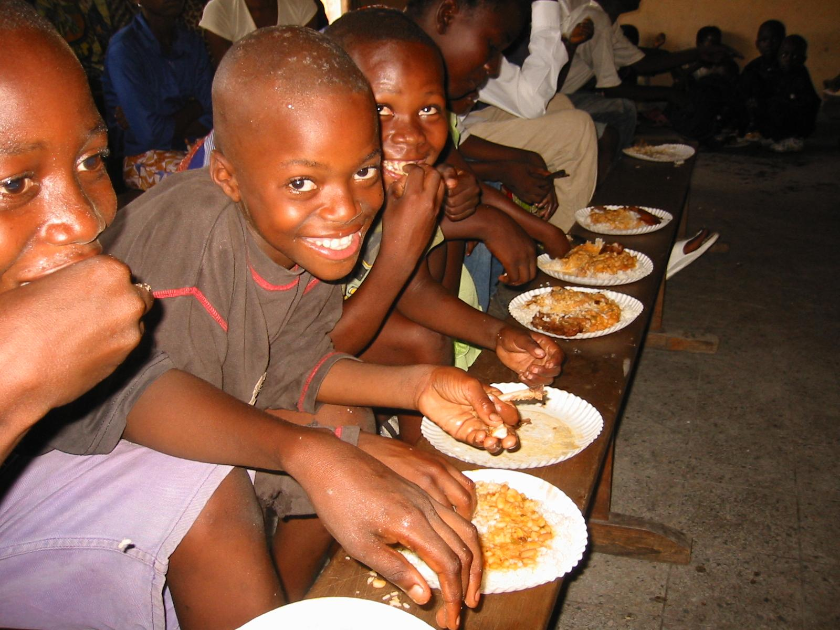
THANK
YOU!!
GOD BLESS

Slide 17
CGI Training & Formation: An Overview
“SERVING OUR NEIGHBOUR FOR THE LOVE OF GOD AND PROMOTING THE DIGNITY OF MANKIND CANNOT BE ACHIEVED BY SECOND-RATE AND SUB-STANDARD PERFORMANCE.
ONLY THE BEST IS GOOD ENOUGH”
BLESSED FREDERIC OZANAM

Slide 18
CGI Training & Formation: An Overview
Early Beginnings
Global Training for Conferences & Conference Officers
Building An International Training Structure
Spiritual Advisers Formation Programme
Some Questions?
“We Took the Road Together; We Will Finish it Together.” Blessed Frederic, 1833

Slide 19
CGI Training & Formation: An Overview
Early Beginnings
Training Programme for National Presidents
ITVPs Trained to Deliver Training Programme
Programme Delivered by ITVPs to over 80% of National Presidents
Reports Back were Positive

Slide 20
CGI Training & Formation: An Overview
Training Programme for National Presidents
Introduction
Our Spirituality
Our Society
Presentation & Communication Skills
Leadership Skills: An Introduction
Teambuilding
Conducting Effective Meetings
Analysis, Review & Evaluation

Slide 21
CGI Training & Formation: An Overview
Current!
Global Training for Conferences & Conference Officers
Working Party: Canada; USA; Brazil; Ireland; England & Wales; France & Italy plus CGI February 2015
Conference Modules Identified & Completed
Conference Officer Modules Identified & Completed
Translation of All Modules into Four Languages in Progress
Recruitment of International Trainers in Progress

Slide 22
CGI Training & Formation: Universal Training General Programme
 General Introduction
 History/Origins
 Spirituality
 Global Poverty & Systemic change
 Visiting those in need
 The Rule: Structure & Governance
 The Conference life
 Vincentian solidarity : Special Works, Projects, Twinnges
 Youth & Young Adults
 Relations with International Organisations and with the Church

Slide 23
Conference Leadership Training
Module 1
Servant Leader
Leadership Styles/Skills
Team Building
Delegation
Accountability
Personal/Professional Development
Succession Planning

Slide 24
Conference Leadership Training
Module 2
Managing a Meeting
Effective/ Efficient Chairing a Meeting
Decision Making/ Consensus
Listening Skills

Slide 25
Conference Leadership Training
Module 3
Roles & Responsibilities
Recruitment
Fundraising
Election/Selection pf Conference Officers

Slide 26
Blessed are the Merciful
Mary in the Magnificant proclaims that God
‘… casts the mighty away from their thrones …. Sends the rich away empty’ (Lk 1:46-55)
God has chosen to stand with the lowly who remember his mercy.
Where do we stand?
Whose values do we share? Do we remember the lowly?

Slide 27
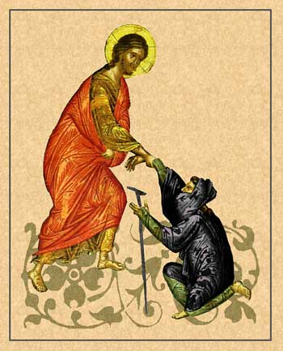
Lord be Merciful to Me a Sinner

